Slide 1
18
Dividends and Dividend Policy

Slide 2

Chapter 18 – Index of Sample Problems
Slide # 02 - 03 Ex-dividend date
Slide # 04 - 05 Homemade dividends
Slide # 06 - 07 Residual dividend
Slide # 08 - 11 Cash dividend vs. Share repurchase
Slide # 12 - 15 Small stock dividend
Slide # 16 - 19 Stock dividend vs. Stock split
Slide # 20 - 22 Reverse stock split
Slide # 23 - 28 Stockholder position

Slide 3
2: Ex-dividend date
The Marla James Co. declared a dividend of $1.50 a share to holders of record on Thursday, July 19. The dividend is payable on July 31. Suzie purchased 100 shares of Marla James stock on Tuesday, July 17. Jim purchased 100 shares of Marla James stock on Monday, July 16.
How much did Suzie receive in dividends on July 31?
How much did Jim receive in dividends on July 31?

Slide 4
3: Ex-dividend date
Suzie will receive $0 on July 31 because she bought the stock on the ex-dividend date.
Jim will receive $1.50 a share for a total of $150 on July 31 because he bought the stock cum dividend.

Slide 5
4: Homemade dividends
You own 100 shares of Big Boys Burgers. The company will pay a $.50 per share dividend this year and a final liquidating dividend of $42 per share next year. The required return on this stock is 14%. Ignore taxes.
What is the current market value of one share of this stock?
What will your homemade dividend per share be next year if you do not want any dividend this year?

Slide 6
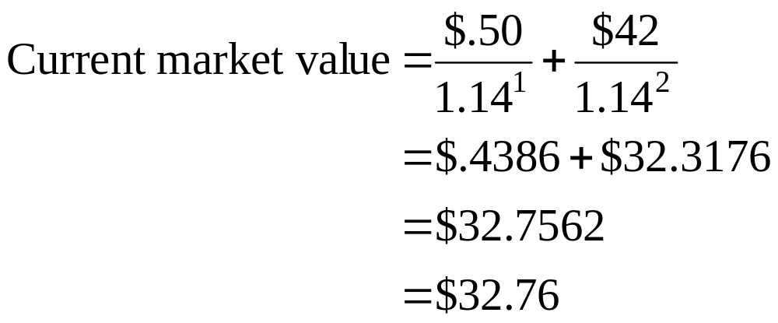
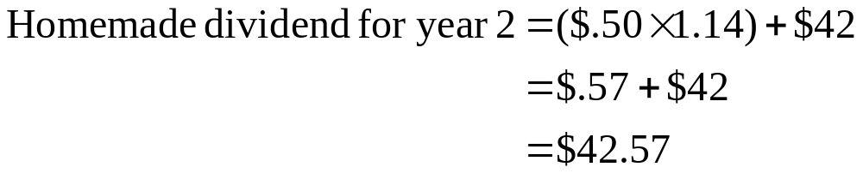
5: Homemade dividends

Slide 7
6: Residual dividend
Food, Etc. has after-tax earnings of $1,300 for the year. The company maintains a debt/equity ratio of .60 and has a residual dividend policy. $1,500 is needed for new investments.
What is the amount of new borrowing?
What amount, if any, is paid out in dividends?

Slide 8
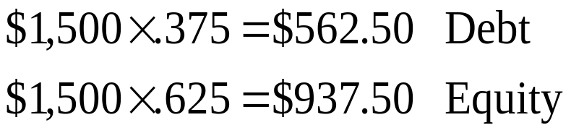
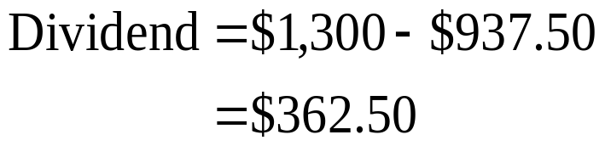
7: Residual dividend
Weight
D = .6 37.5%
E = 1.0 62.5%
V = 1.6 100.0%

Slide 9
8: Cash dividend vs. Share repurchase
Net income = $750 Market value = Book value | Current | $1,000 cash Dividend | $1,000 share repurchase
Excess cash | $1,000
Other assets | $9,000
Equity | $10,000
# of outstanding shares | 5,000
Earnings per share | $.15
Stock price | $2.00
Dividend per share | $0
Stockholder value per share | $2.00

Slide 10
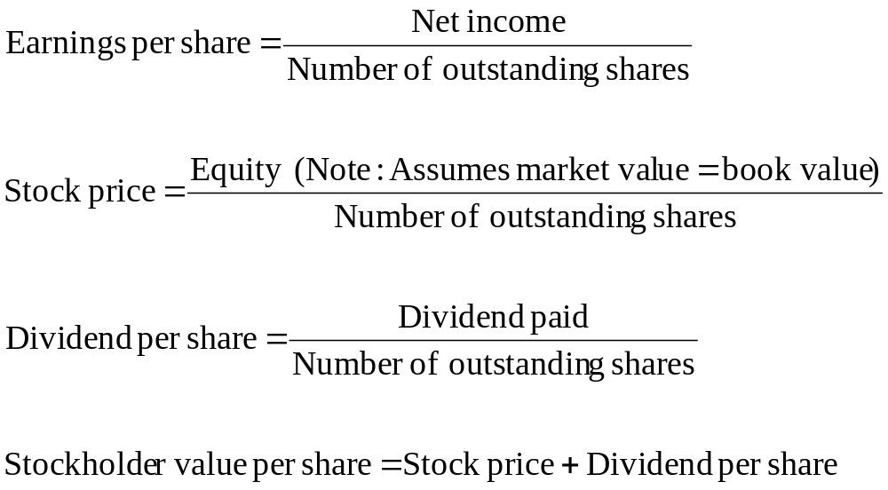
9: Cash dividend vs. Share repurchase

Slide 11
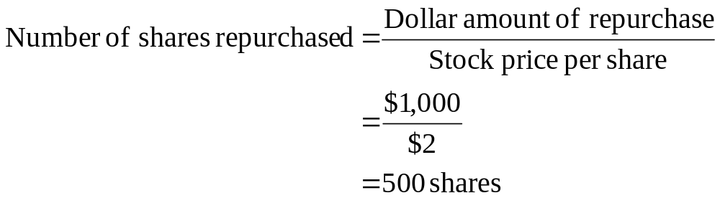
10: Cash dividend vs. Share repurchase

Slide 12
11: Cash dividend vs. Share repurchase
Net income = $750 | Current | $1,000 cash Dividend | $1,000 share repurchase
Excess cash | $1,000 | $0 | $0
Other assets | $9,000 | $9,000 | $9,000
Equity | $10,000 | $9,000 | $9,000
# of outstanding shares | 5,000 | 5,000 | 4,500
Earnings per share | $.15 | $.15 | $.1667
Stock price | $2.00 | $1.80 | $2.00
Dividend per share | $0 | $.20 | $0
Stockholder value per share | $2.00 | $2.00 | $2.00

Slide 13
12: Small stock dividend
 | Current | 10% (small) stock dividend
Common stock | $5,000
Capital in excess of par | $20,000
Retained earnings | $10,000
Total equity | $35,000
# of outstanding shares | 5,000
Par value | $1
Book value per share | $7.00
Market value per share | $10.00
Total market value | $50,000

Slide 14
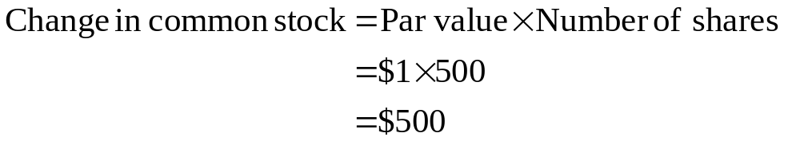
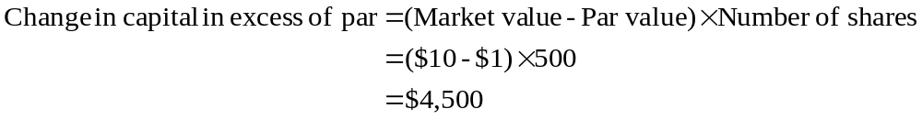
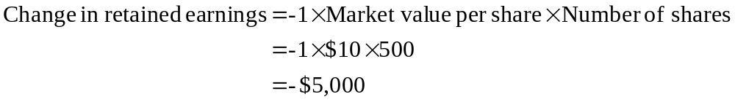
13: Small stock dividend

Slide 15
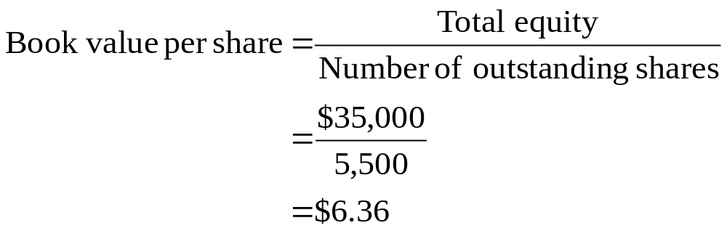
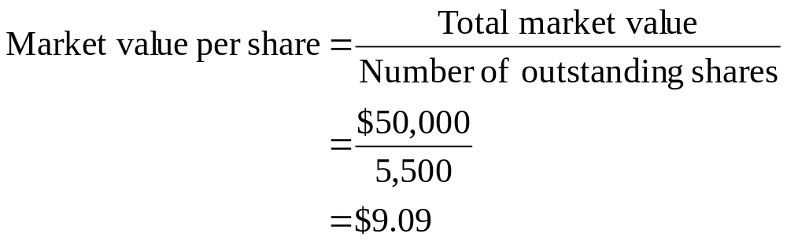
14: Small stock dividend

Slide 16
15: Small stock dividend
 | Current | 10% (small) stock dividend
Common stock | $5,000 | $5,500
Capital in excess of par | $20,000 | $24,500
Retained earnings | $10,000 | $5,000
Total equity | $35,000 | $35,000
# of outstanding shares | 5,000 | 5,500
Par value | $1 | $1
Book value per share | $7.00 | $6.36
Market value per share | $10.00 | $9.09
Total market value | $50,000 | $50,000

Slide 17
16: Stock dividend vs. Stock split
 | Current | 50% (large) stock dividend | 3-for-2 stock split
Common stock | $5,000
Capital in excess of par | $20,000
Retained earnings | $10,000
Total equity | $35,000
# of outstanding shares | 5,000
Par value | $1
Book value per share | $7.00
Market value per share | $10.00
Total market value | $50,000

Slide 18
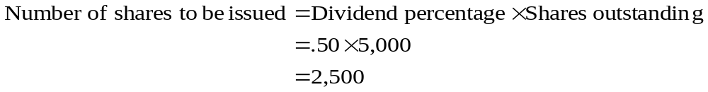
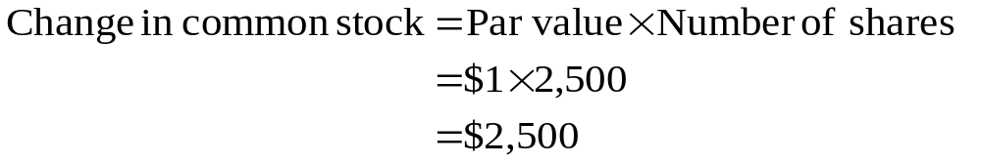
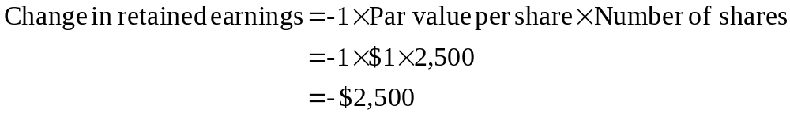
17: Stock dividend vs. Stock split
50% (large) stock dividend:

Slide 19
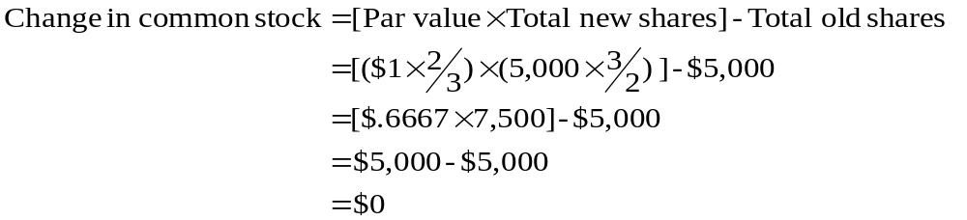
18: Stock dividend vs. Stock split
3-for-2 stock split:

Slide 20
19: Stock dividend vs. Stock split
 | Current | 50% (large) stock dividend | 3-for-2 stock split
Common stock | $5,000 | $7,500 | $5,000
Capital in excess of par | $20,000 | $20,000 | $20,000
Retained earnings | $10,000 | $7,500 | $10,000
Total equity | $35,000 | $35,000 | $35,000
# of outstanding shares | 5,000 | 7,500 | 7,500
Par value | $1 | $1 | $.6667
Book value per share | $7.00 | $4.6667 | $4.6667
Market value per share | $10.00 | $6.6667 | $6.6667
Total market value | $50,000 | $50,000 | $50,000

Slide 21
20: Reverse stock split
 | Current | 1-for-4 stock split
Common stock | $5,000
Capital in excess of par | $20,000
Retained earnings | $10,000
Total equity | $35,000
# of outstanding shares | 5,000
Par value | $1
Book value per share | $7.00
Market value per share | $10.00
Total market value | $50,000

Slide 22
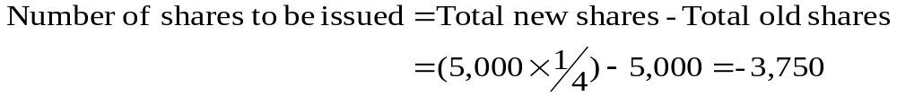
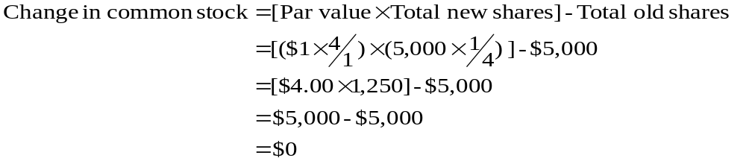
21: Reverse stock split
1-for-4 stock split:

Slide 23
22: Reverse stock split
 | Current | 1-for-4 stock split
Common stock | $5,000 | $5,000
Capital in excess of par | $20,000 | $20,000
Retained earnings | $10,000 | $10,000
Total equity | $35,000 | $35,000
# of outstanding shares | 5,000 | 1,250
Par value | $1 | $4
Book value per share | $7.00 | $28.00
Market value per share | $10.00 | $40.00
Total market value | $50,000 | $50,000

Slide 24
23: Stockholder position
Alberto currently owns 2,000 shares of Fido, Inc. These shares closed at a price of $24 a share today. Tomorrow, a 5-for-3 stock split takes effect.
How many shares will Alberto own tomorrow morning when the market opens?
All else equal, what will the opening stock price be?

Slide 25
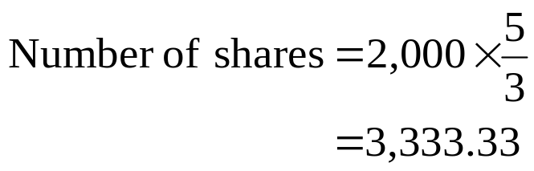
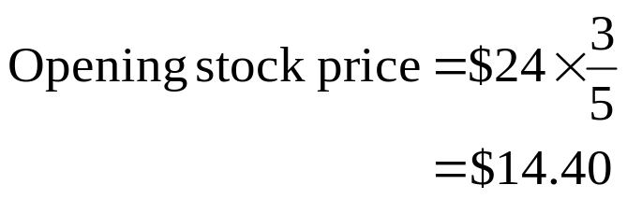
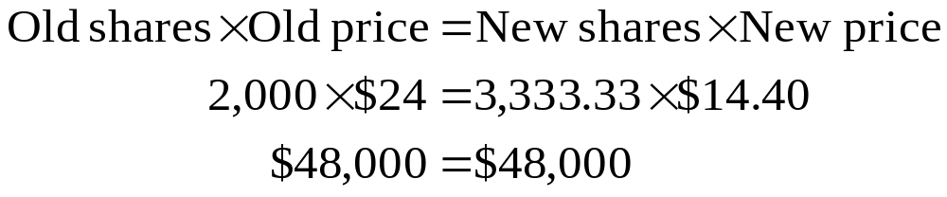
24: Stockholder position

Slide 26
25: Stockholder position
Winifred owns 1,000 shares of Me, Inc. The shares closed today at a market price of $2.10 a share. Tomorrow, a 1-for-5 reverse stock split takes effect. Ignore taxes.
How many shares will Winifred own tomorrow morning when the market opens?
All else equal, what will the opening price per share be?

Slide 27
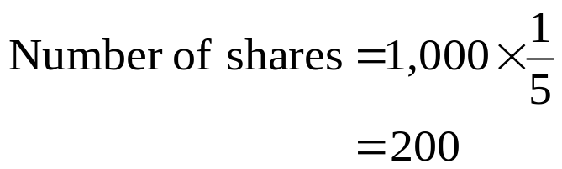
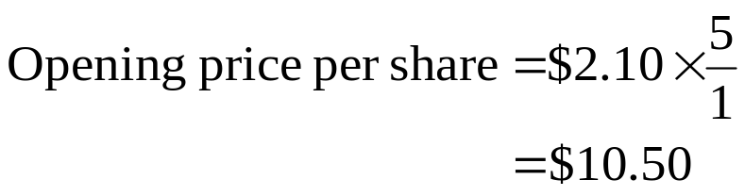
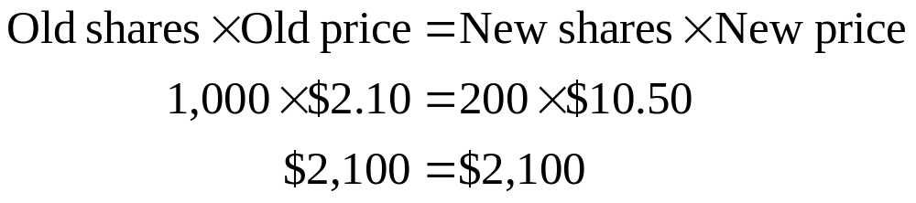
26: Stockholder position

Slide 28
27: Stockholder position
Mr. DooLittle owns 500 shares of Lazy, Inc. valued, as of tonight’s close, at $15 a share. A 15% (small) stock dividend is payable tomorrow. Ignore taxes.
How many additional shares will Mr. DooLittle acquire due to this stock dividend?
What will be the value of Mr. DooLittle’s investment in Lazy, Inc. after the stock dividend is distributed, all else equal?

Slide 29
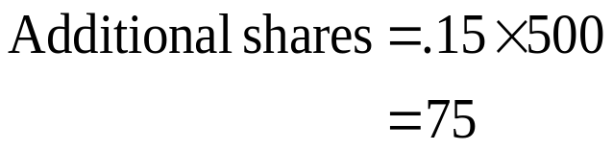
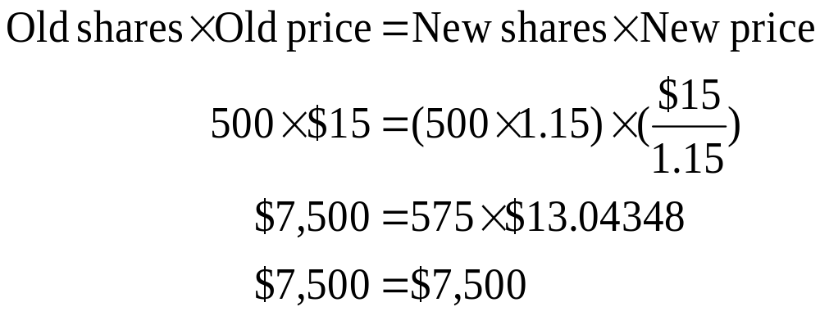
28: Stockholder position

Slide 30
18
End of Chapter 18

